Slide 1
Downtown Task Force 6-Month Update
November 20, 2023

Slide 2
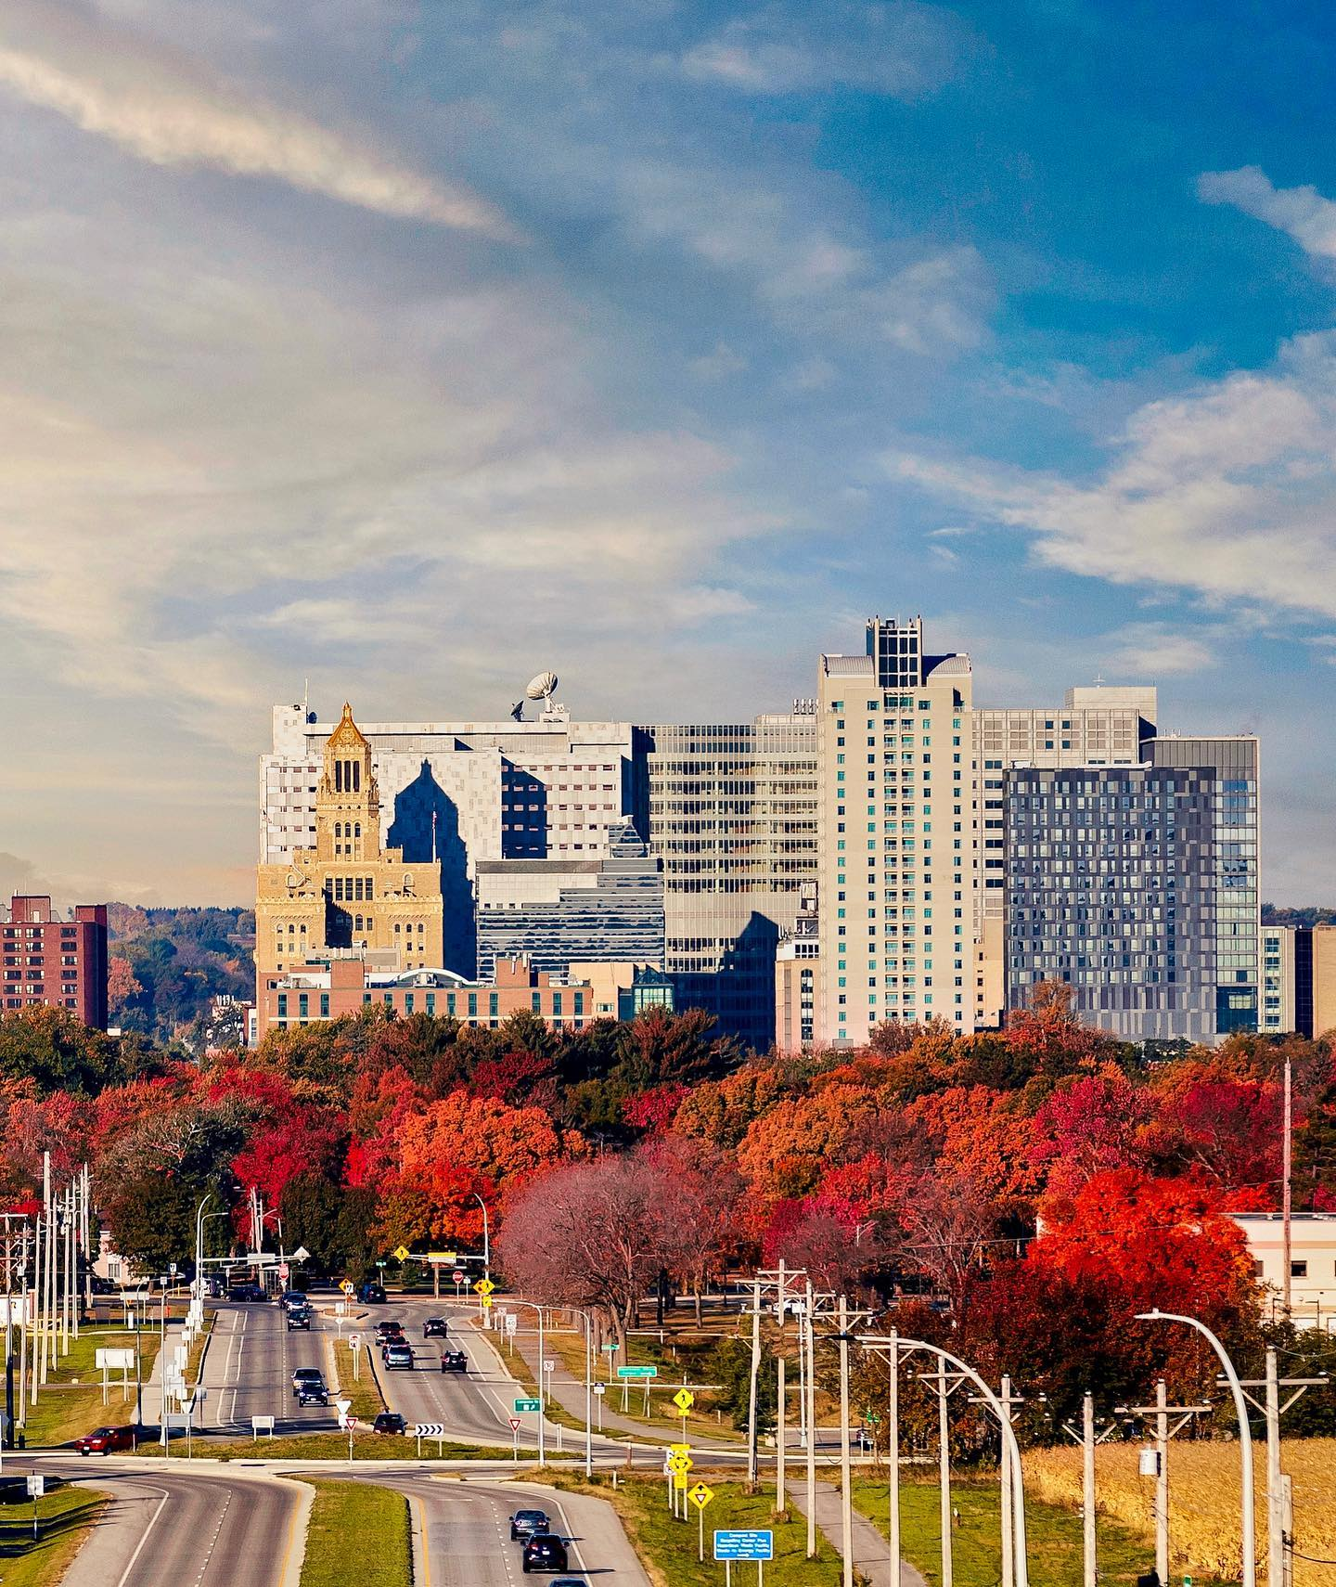
Today’s
Discussion
Background
Progress
Key Takeaways
Future Planning
Discussion
Notes:
Bold slide for sections or callout information- 3 colors: orange, blue, grey

Slide 3
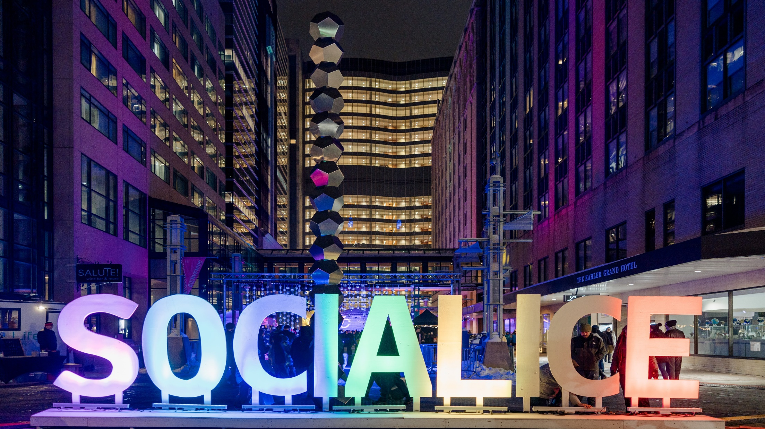
Background
HOW DID WE GET HERE
Long-Lasting Impacts of the Pandemic
Changed how and where people work, shop, and conduct other activities, impacting the ecosystems of downtowns across the country
Question?
What can we do, in a collaborative way, to help downtown continue to recover and build a more resilient downtown for the future?

Slide 5
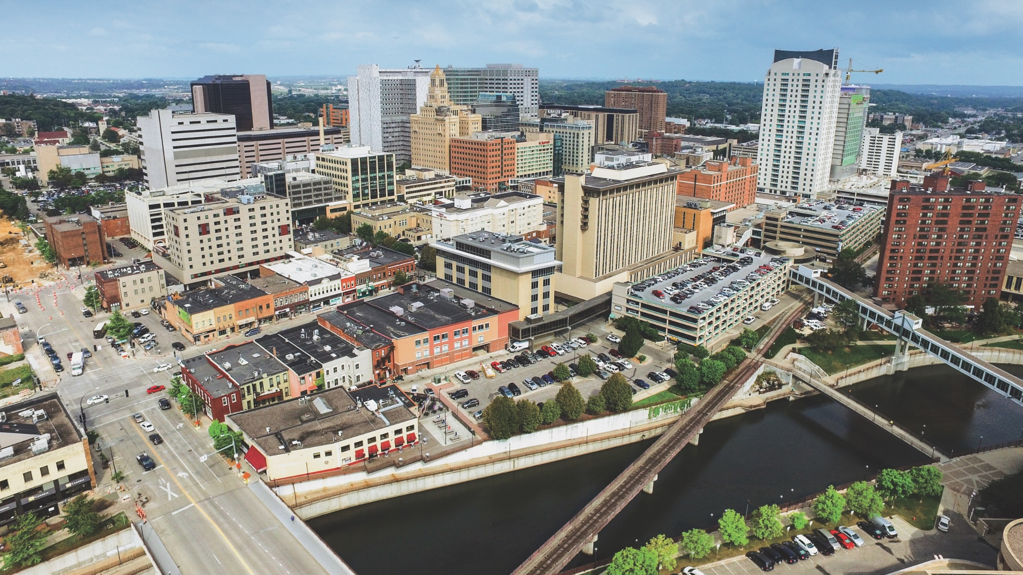
Building the Action Plan in 90 Days
Feb + Mar
April + May
May
Phase 1: Consensus on key themes/Issues
Phase 2: Build a draft list of recommended action items + share with community
Mid-May
Begin implementation and communications roll-out
Working Sessions
Working
Sessions
Continued Collaborations
Survey

Slide 6
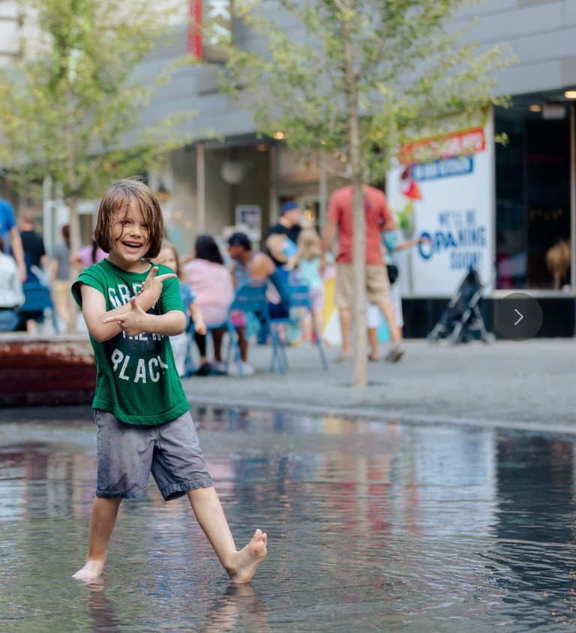
Four Main Themes
Working Session Findings
Promotion, Activation, and Programming
Access to Downtown
Barriers to Doing Business
Growing Downtown
Notes:
Bold slide for sections or callout information- 3 colors: orange, blue, grey

Slide 7
Progress
What has been accomplished so far?
6-Month Report Highlights
Continued to meet on a regular basis
Solving for community concerns
Troubleshooting immediate needs
Notes:
Bold slide for sections or callout information- 3 colors: orange, blue, grey

Slide 8
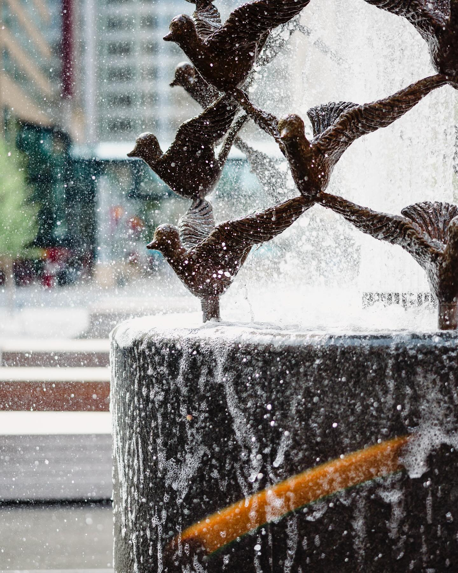
Progress
Task Force Member Highlights
Rochester Downtown Alliance
Experience Rochester
Rochester Area Chamber of Commerce
City of Rochester
Mayo Clinic
Rochester Area Economic Development Inc.
Destination Medical Center
Notes:
Bold slide for sections or callout information- 3 colors: orange, blue, grey

Slide 9
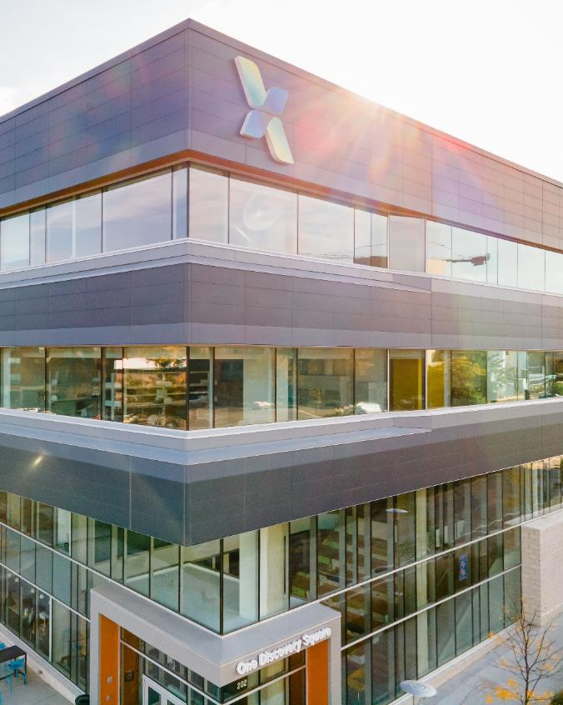
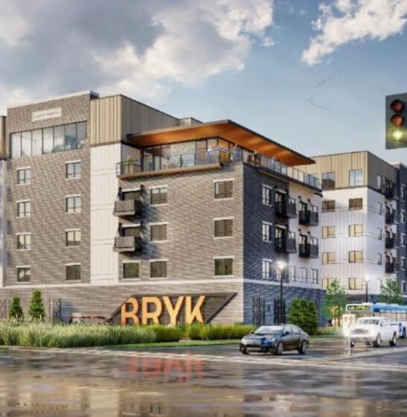
Downtowns are Different
They are no longer obligations, they are destinations
Workforce shifts – the hybrid office
Here to stay…for now
Workforce is “choosing” when they come downtown
Local downtown visits have shifted from daytime to evening and weekend
Increase us in public spaces

Slide 10
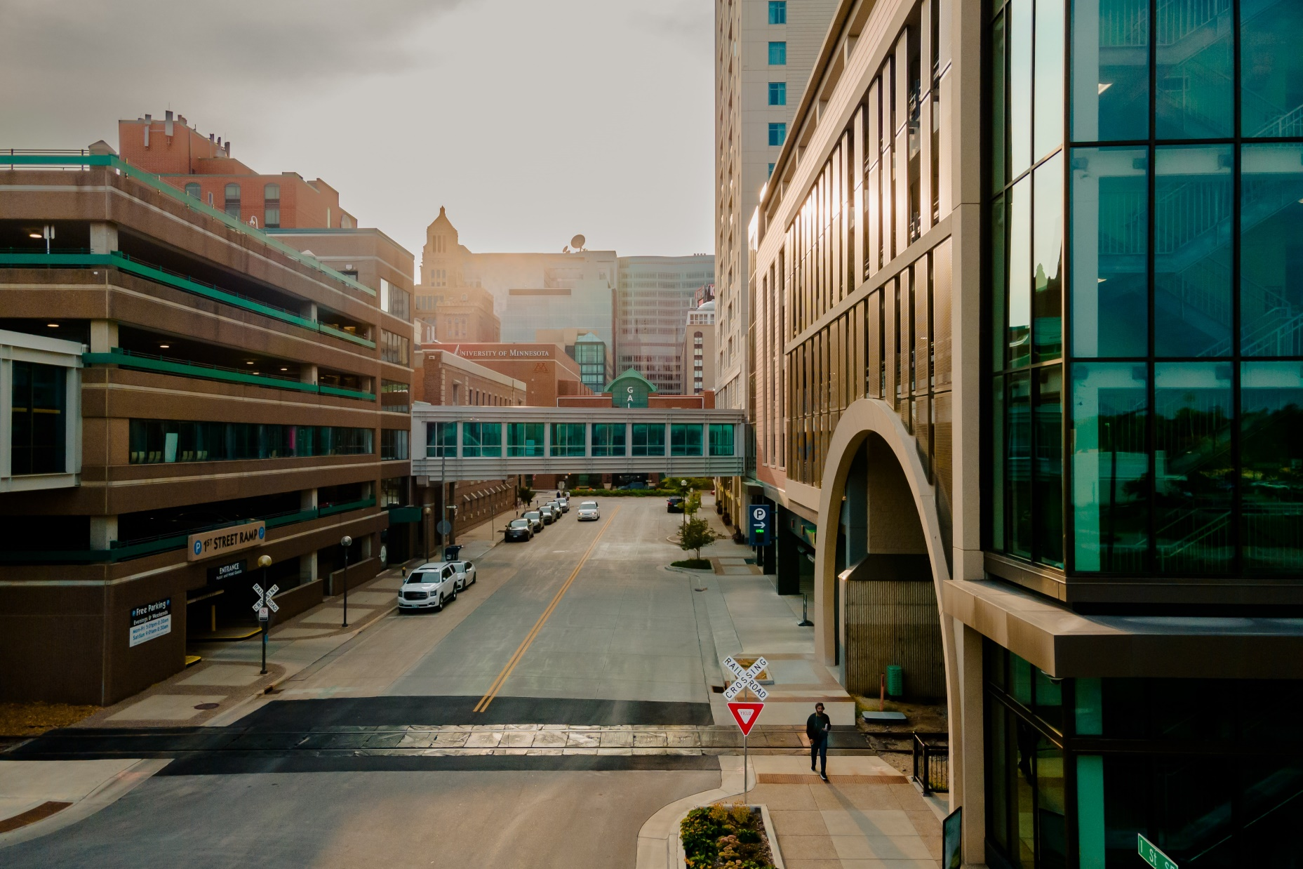
Future Planning
How do we continue to work together?
Upcoming Projects
Bus Rapid Transit
Mayo Clinic Expansion
Retail/Dining/Entertainment Recruitment
Special Topics/Issues
Notes:
Bold slide for sections or callout information- 3 colors: orange, blue, grey

Slide 11
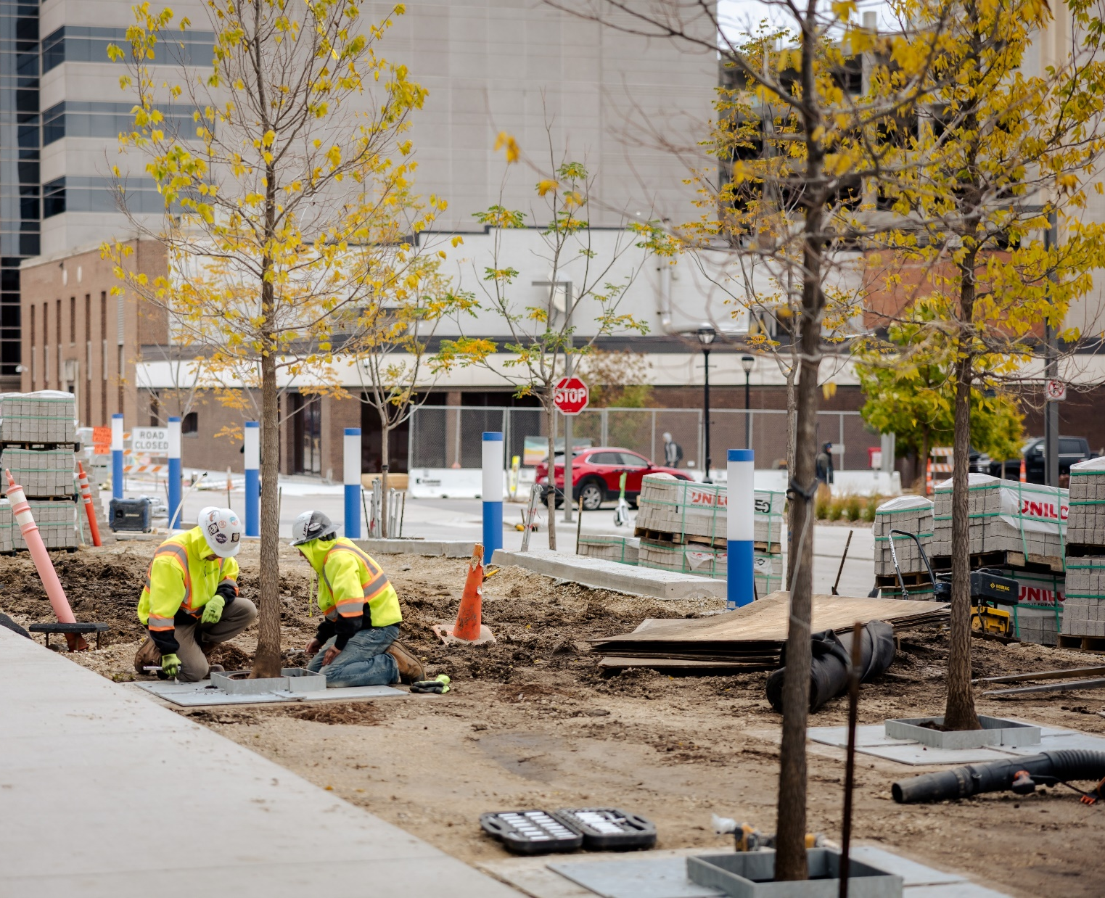
Key Takeaways
What have we learned so far?
The formation of the Task Force created an opportunity to collectively listen to community stakeholders and turn concerns into actions
The Task Force has also created a new way to work together every day – from simple to complex challenges, communications, urgent matters, and regular updates
The importance of using data-driven decision-making and using emerging tools

Slide 12
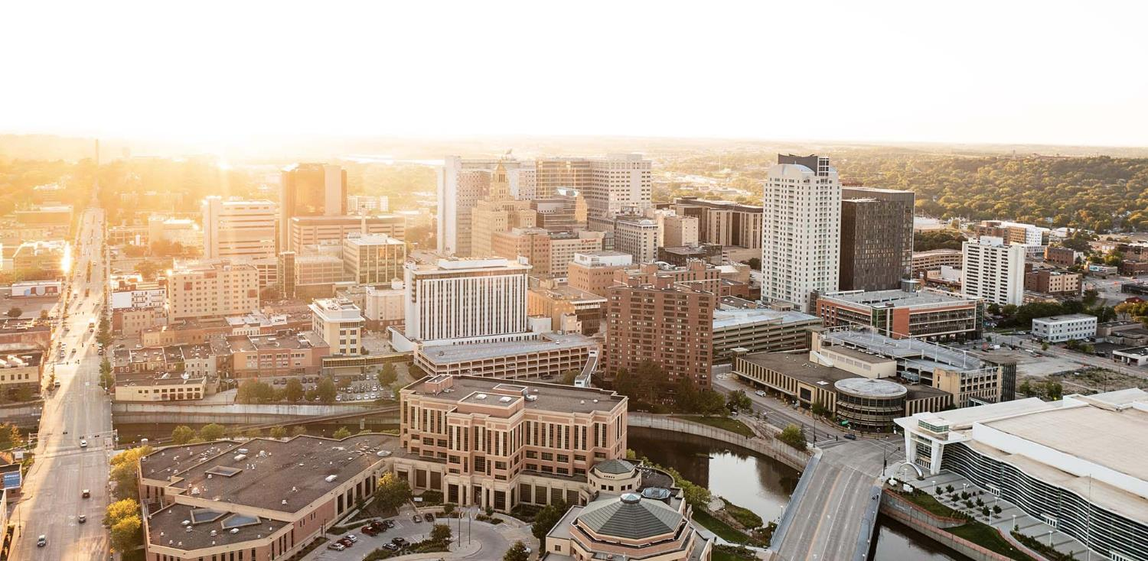
Discussion:
How do you feel we are doing in responding to stakeholder needs?
What other opportunities should we work together on?
Notes:
End Slide.

Slide 13
Thank you

